Slide 1
Backend
Ahmed Ramdan
Backend
Ahmed Osama
Backend
Ahmed Hamdy
Backend
Alaraby
Backend
Hossam Ahmed
E-Commerce Application
Backend
Mohamed Hazem
Supervisor: Eng.Mohamed Abduallah

Slide 2

Team Members
Backend
Ahmed Ramadan
Backend
Ahmed Osama
Backend
Ahmed Hamdy
Backend
Alaraby
Backend
Hossam Ahmed
Backend
Mohamed Hazem

Slide 3

Problem
01.
Introduction

Slide 4



01.
Introduction

Slide 5






Problem
01.
Introduction

Slide 6
Problem

Slide 7
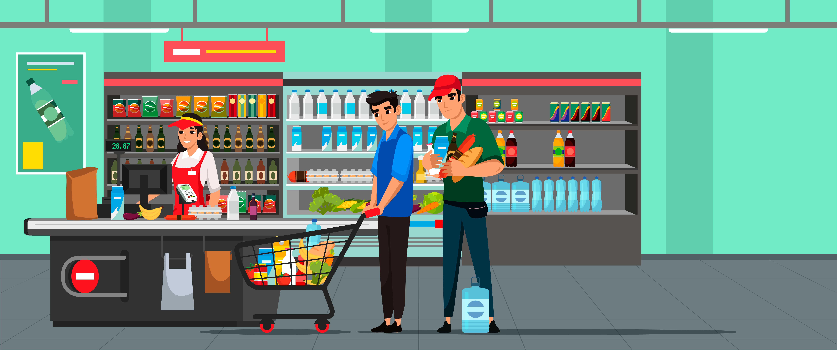

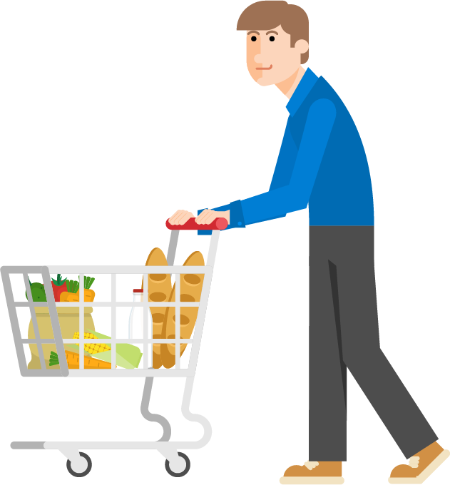

Slide 9

Problem
01.
Introduction

Slide 11
Solution
01.
Introduction
E-Commerce
Application

Slide 12
Solution Process
03
Vendor
Vendors can add new products
01.
Introduction
01
02
Identity
Browser Products
Make user can login and register a account to know who is he.
The user can browser the products as he want
04
ShoppingCart + Order
User can make add products in shopping cart and make a order

Slide 13
Solution Process
03
Vendor
Vendors can add new products
01.
Introduction
01
02
Identity
Browser Products
Make user can login and register a account to know who is he.
The user can browser the products as he want
04
ShoppingCart + Order
User can make add products in shopping cart and make a order

Slide 14
Solution Process
01.
Introduction
01
02
03
Identity
Browser Products
Vendor
Make user can login and register a account to know who is he.
The user can browser the products as he want
Vendors can add new products
04
ShoppingCart + Order
User can make add products in shopping cart and make a order

Slide 15
Solution Process
System Architecture
01.
Introduction
01
02
03
04
Identity
Browser Products
Vendor
ShoppingCart + Order
Make user can login and register a account to know who is he.
The user can browser the products as he want
Vendors can add new products
User can make add products in shopping cart and make a order

Slide 16





System Architecture
Cloud
Response
Request
Request
Request
Web
Client
04
Data
Database
01
02
03
.NET Server
Data
Application Interface
Identity
Browser Products
Vendor
ShoppingCart + Order
Make user can login and register a account to know who is he.
The user can browser the products as he want
Vendors can add new products
User can make add products in shopping cart and make a order

Slide 17


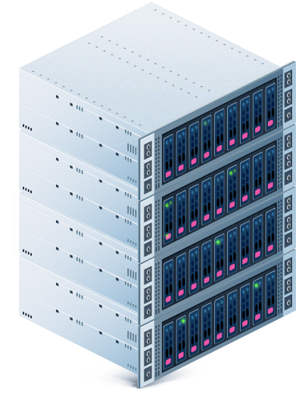

Client Side
Mobile,Web Applications
Database
SQL SERVER

Slide 18

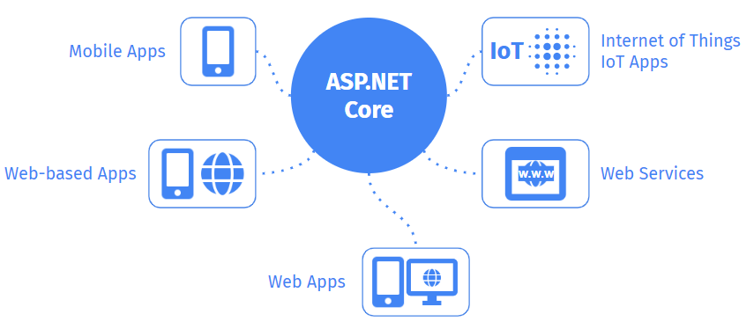
ASP.NET Core is a cross-platform, high-performance, open-source framework for building modern, cloud-enabled, Internet-connected apps.
Scalability, performance, security, and ease of development.
We used code first to create the database schema from the codebase.
The database schema was automatically generated based on the classes and properties defined in the codebase.
This approach helped to ensure consistency between the codebase and the database schema.

Slide 19
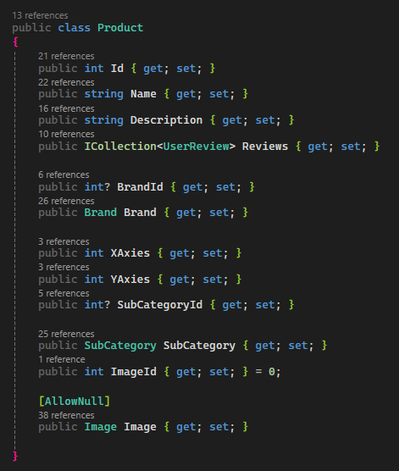


ORM
(Object Relational Mapper)
ORM
Products
Id
Name
Price
TotalPrice
InventoryId
Description
Left
BrandId
ImageURL
SupplyId
CategoryId
{ }
Class in Code
Table in Database

Slide 20
.NET
ORM
Products
Id
Name
Price
TotalPrice
InventoryId
Description
Left
BrandId
ImageURL
SupplyId
CategoryId
CRUD Operation
{ }
Class in Code
Table in Database

Slide 21




.NET
ORM
CRUD Operation
Products
Id
Name
Price
TotalPrice
InventoryId
Description
Left
BrandId
ImageURL
SupplyId
CategoryId
Create
Read
Update
Delete
{ }
Class in Code
Table in Database

Slide 22
.NET
Security

Slide 23

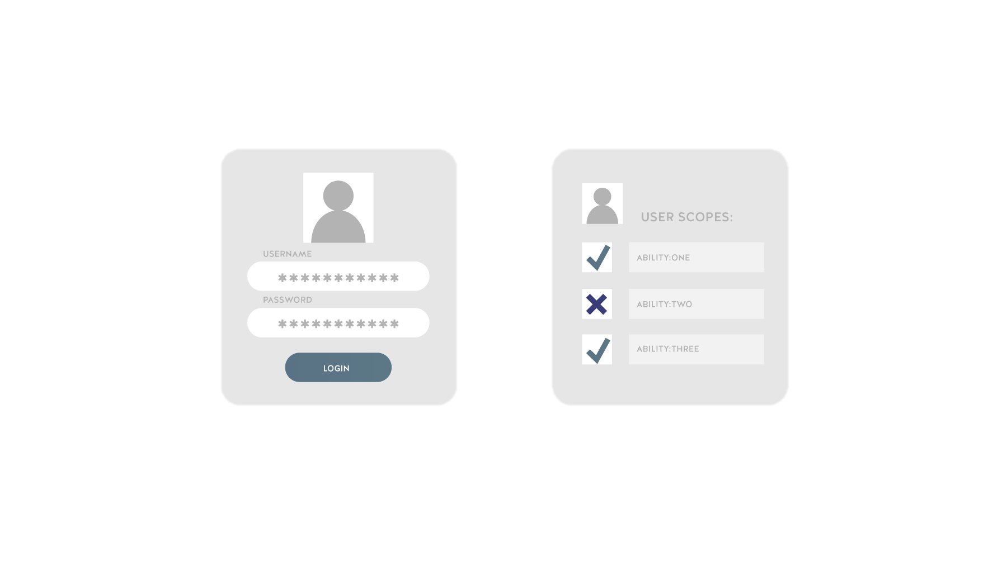
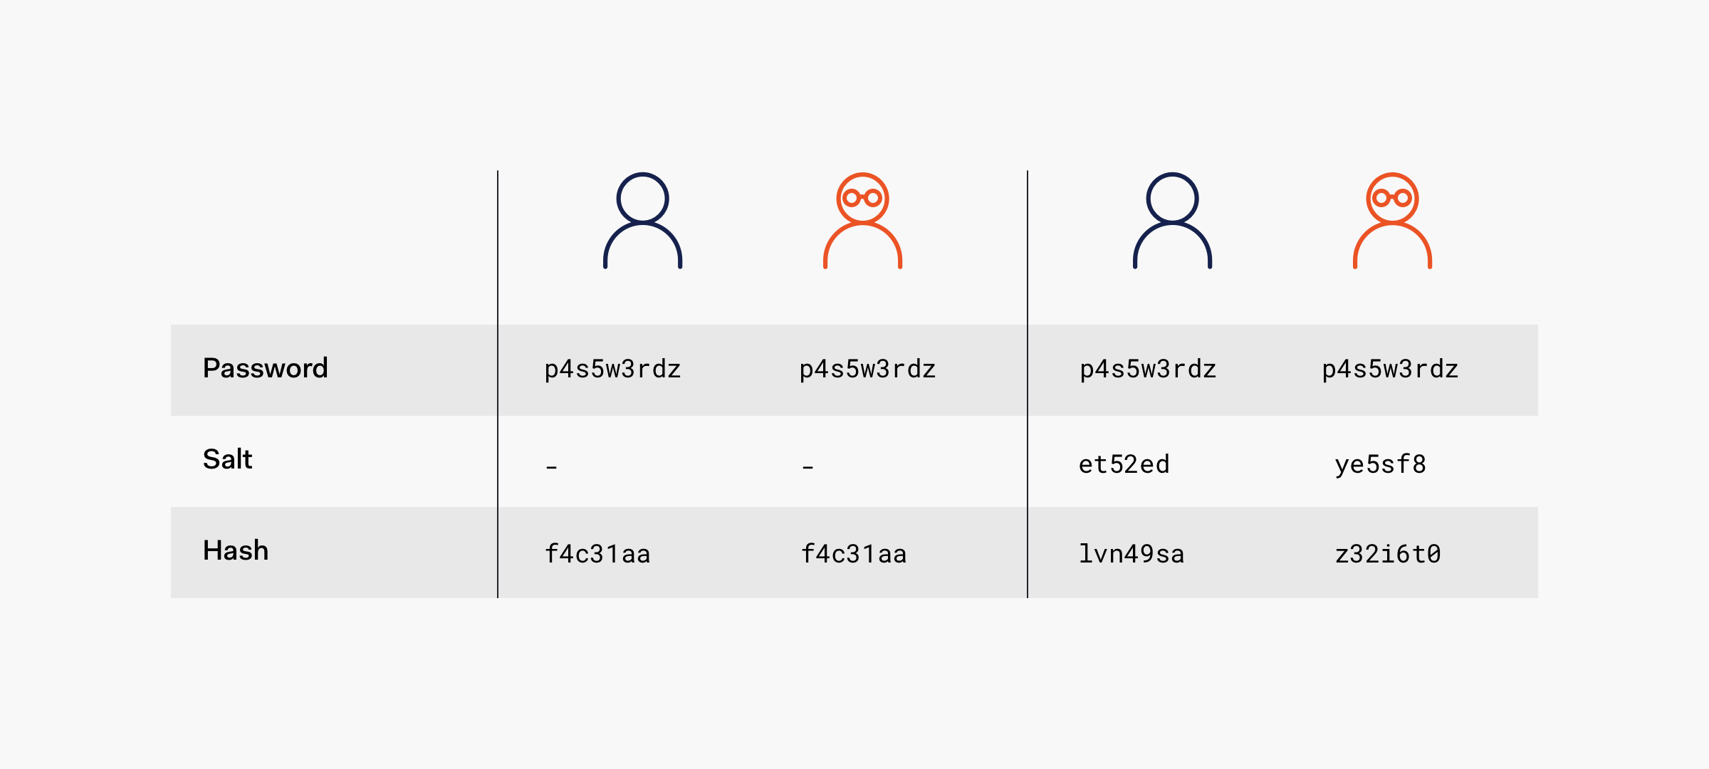
.NET
Security
Authentication
Authorization
User 1
User 2
VS
WHO ARE YOU?
CAN YOU DO THAT?

Slide 24
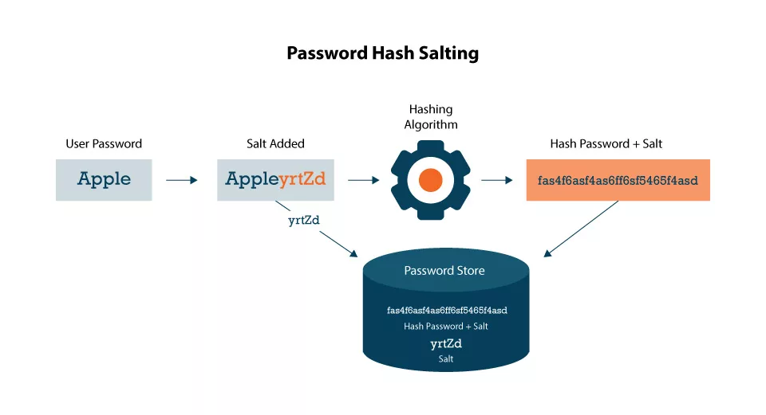
.NET
Security
Password Hashing Salting
Authorization
Authentication
User 1
User 2
VS
CAN YOU DO THAT?
WHO ARE YOU?

Slide 25

.NET
Security
Password Hashing Salting
Token
Authentication
User 1
User 2
WHO ARE YOU?

Slide 26


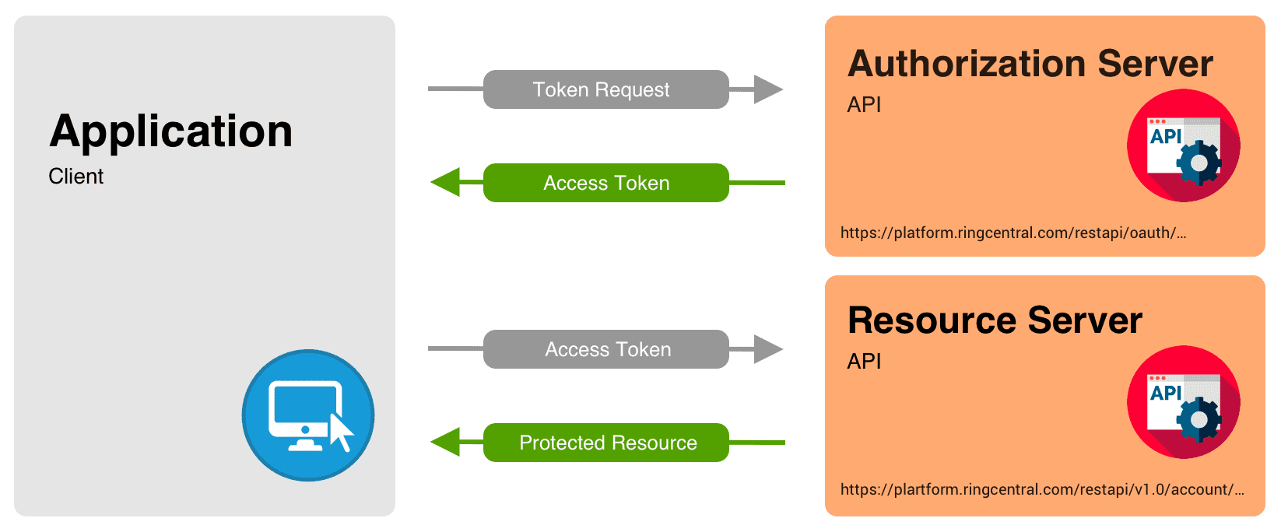
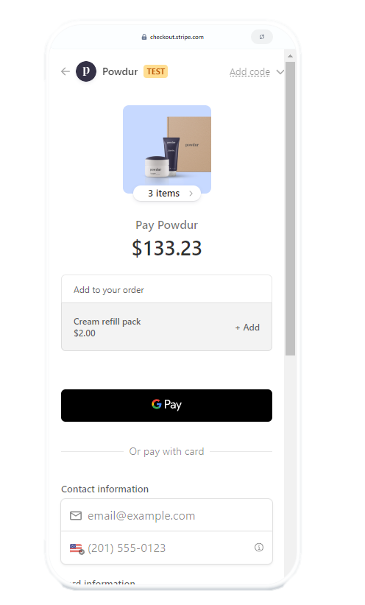
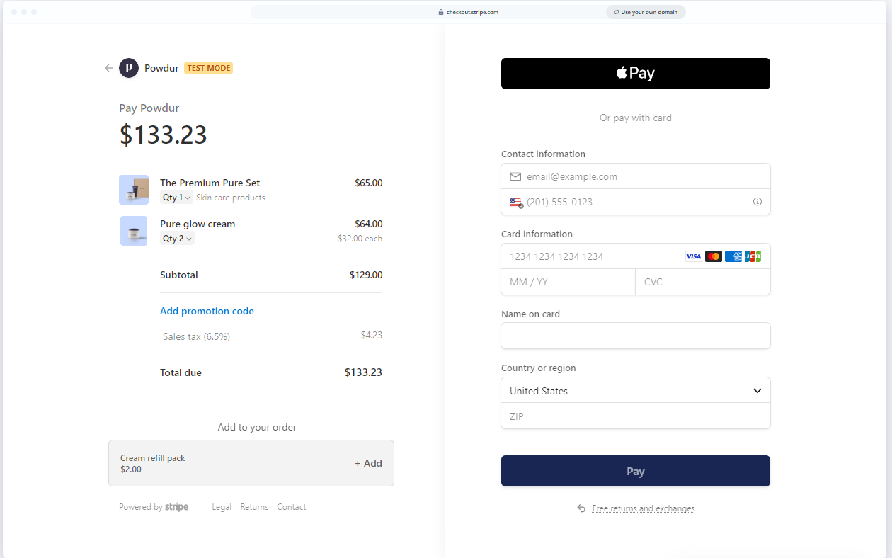
.NET
Security
Authentication
Authorization
1
Permission
Roles
Add Product
User1
2
Admin
3
Customer
Permission
Browser Products
WHO ARE YOU?
CAN YOU DO THAT?
User2
Web Application
Mobile Application

Slide 27
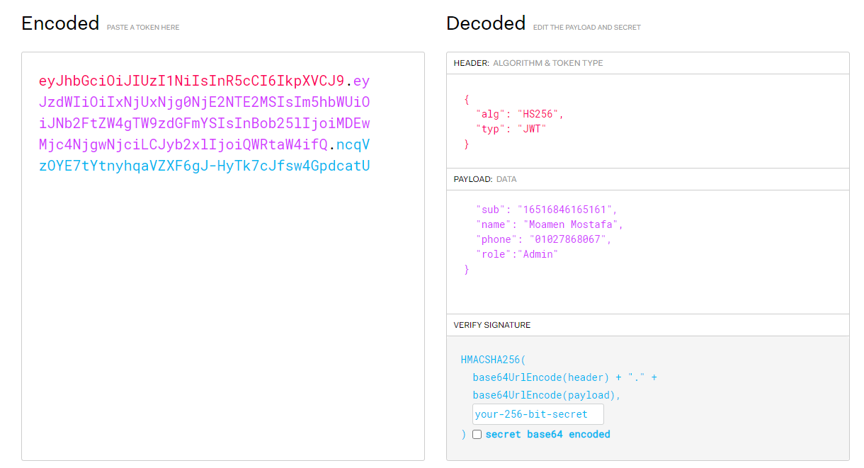
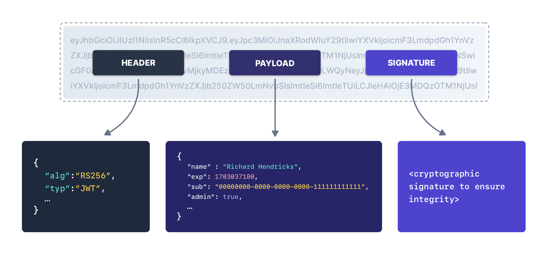
.NET
Password Hashing Salting
Security
Token
Authentication
WHO ARE YOU?
Roles
Permission
Add Product
User1
Admin
Customer
Permission
Browser Products
User2

Slide 28
.NET
Password Hashing Salting
Security
Token
Authentication
WHO ARE YOU?

Slide 29
.NET
Password Hashing Salting
Security
Token
Authentication
WHO ARE YOU?

Slide 30



Categories
Product Variety
RETAIL STORE
Who Can Add Category
.

Slide 31
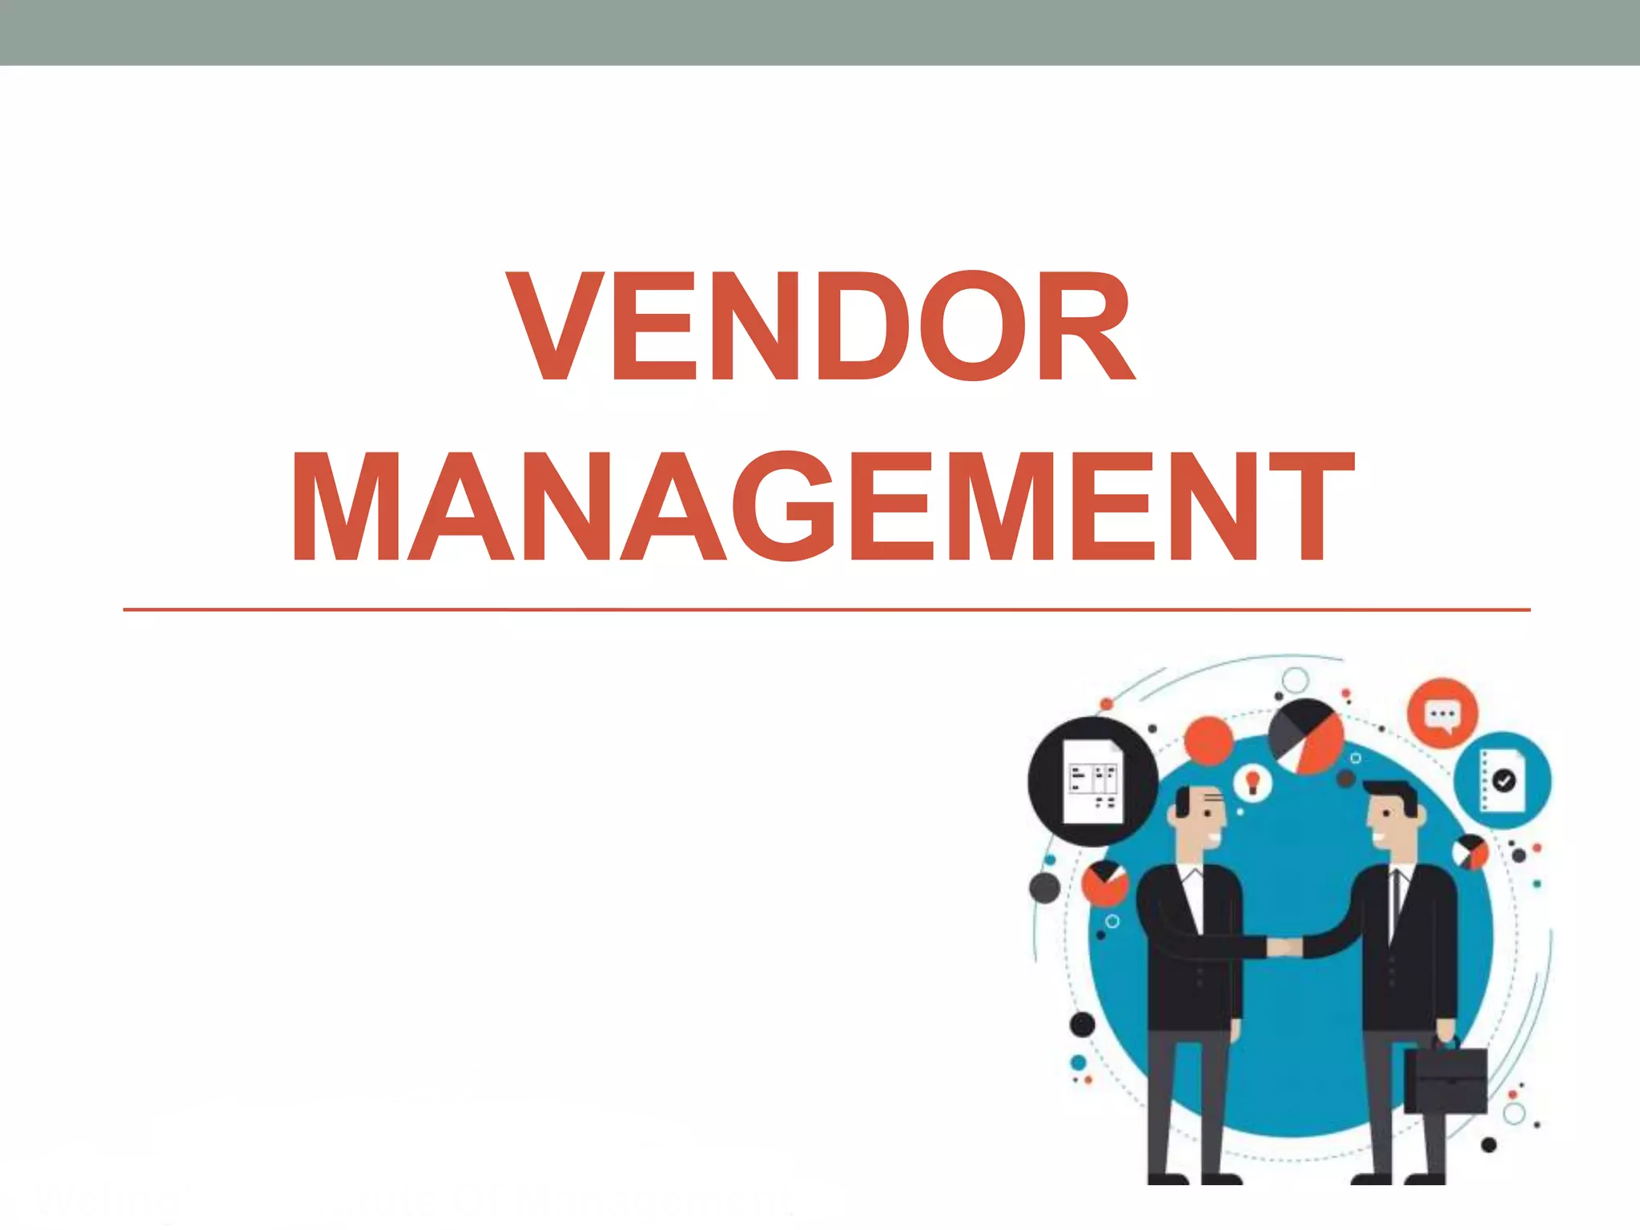


Slide 32


Vendor Dashboard
The Vendor Dashboard is a central hub for vendors to manage their products efficiently.
It allows vendors to:
Add, Edit, and Delete Products: Vendors can create new product listings or modify existing ones.
Upload and Manage Product Images: Vendors can upload multiple images for each product, offering customers a better view of the item.
Monitor Product Details: Keep track of product stock levels, pricing, and categories.
Key Features of the Vendor Dashboard:
User-friendly Interface: Designed to be intuitive, enabling vendors to manage their products with ease.
Category Assignment: Products can be assigned to specific categories for better organization and visibility.
The Vendor Dashboard is a central hub for vendors to manage their products efficiently.
It allows vendors to:
Add, Edit, and Delete Products: Vendors can create new product listings or modify existing ones.
Upload and Manage Product Images: Vendors can upload multiple images for each product, offering customers a better view of the item.
Monitor Product Details: Keep track of product stock levels, pricing, and categories.
Key Features of the Vendor Dashboard:
User-friendly Interface: Designed to be intuitive, enabling vendors to manage their products with ease.
Category Assignment: Products can be assigned to specific categories for better organization and visibility.

Slide 33
.NET
Shopping Cart

Slide 34






How to Order ?
Browse
product
Add
to cart
Sign In
Make
a payment
Wait for
delivery

Slide 35
Implementation
01
02
03
Model
Controller
Represents a customer's shopping cart item.
Managing User Actions
Session
Enables persistence of cart data while the user is navigating the site.

Slide 36
Shopping Cart Feature.
Adding
Remove
Memory
View
Prushes
Counter

Slide 37
How it Works?
S
s

Slide 38
Workflow
Cart and Cart Item Models:
The Cart model manages the collection of items a customer wants to purchase, while the Cart Item model holds individual product details (e.g., product name, quantity, price).
Controller Actions:
View Cart: Displays all items in the cart.
Add Item: Adds a selected product to the cart.
Delete Item: Removes a product from the cart.
Proceed to Purchase: Transfers cart items to an order, stores order details, and clears the session.
Session Management for Cart:
Two extensions were created to manage storing cart items in the session:
One to retrieve the cart items.
One to store the updated cart back into the session.
Cart Counter on Navbar:
A counter is implemented to dynamically show the number of items in the cart on the navbar, visible only to users with a customer role.

Slide 39
E-Commerce Application
Thank you for Listening

